Slide 1
Medical Images Classification
Karam Abu Mokh

Slide 2
Main Goals
Architecting a CNN to classify medical images
Train the model with MedNIST Dataset
Creating an augmented dataset
Train the model with augmented Dataset
Compare the same two models with different training Datasets

Slide 3
Introduction
AI and CNN in radiological image processing and diagnosis.
This algorithms has not come at the price of accuracy.
Human experts and AI.
Data Augmentation
Increase the Dataset

Slide 4
Setup the frameworks
Numpy
OS
Time
Matplotlib
PIL -> Image
Torch
sklearn.metrics -> confusion_matrix, accuracy_score
mlxtend.plotting -> plot_confusion_matrix

Slide 5
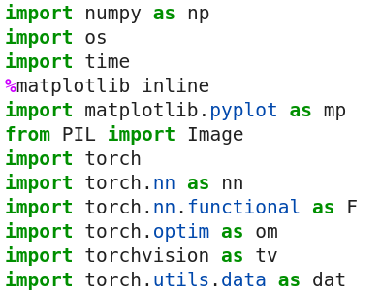
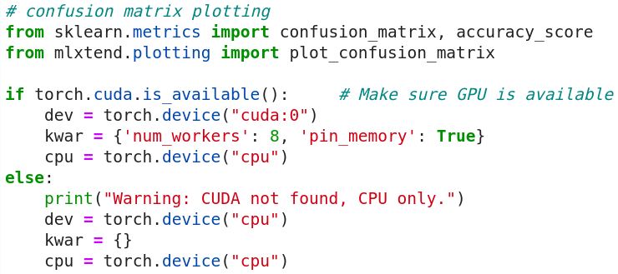

Slide 6
Prepare the Data
Read the images.
Make the labels array.
Partitioning into Training, Validation, and Testing Sets.

Slide 7


Read the images & Creating the labels array

Slide 8

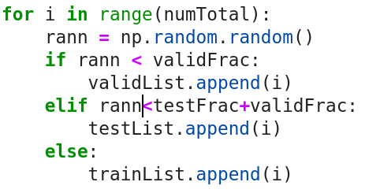
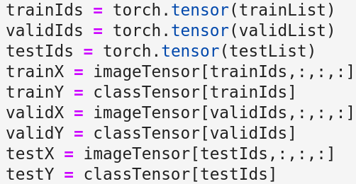
Partitioning into Training, Validation, and Testing Sets.

Slide 9
Model Architecture
Convolutional layers
Fully connected layers

Slide 10
Convolutional layers
When interpreting an image, the eye first identifies edges and boundaries. Then, building on these features, one can make out curves, shapes, and more complex structures at higher levels of abstraction.
By only combining information from nearby pixels at first, a series of convolutional layers mimics this organic process.

Slide 11
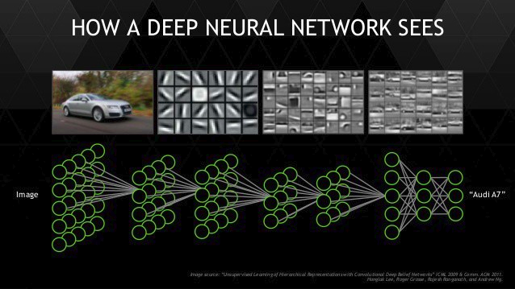

Slide 12
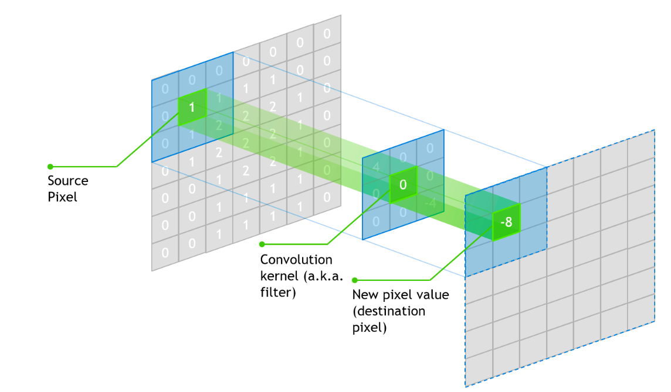

Slide 13
Convolutional layers
The value of each pixel of the convolutional kernel - these are the weights that are trained.
multiplied with the corresponding pixel value within the neighborhood of the original, central image pixel.
These products are summed up, and the total is placed in the central pixel of the new layer.
The process is repeated for each pixel and each convolution within the layer.

Slide 14
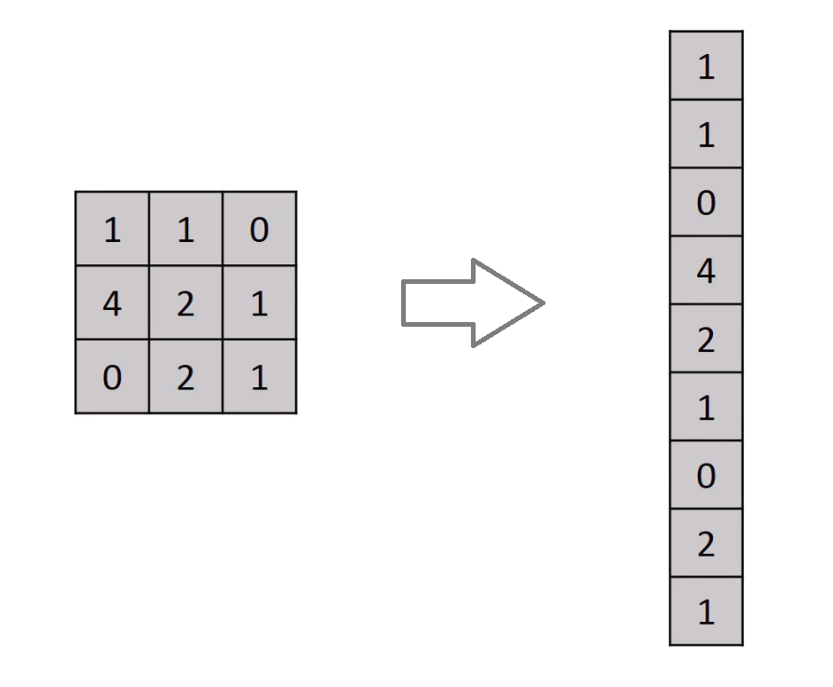
Flattening
all the information from
the last layer is "flattened" into a vector.

Slide 15
Fully connected layers
In a fully connected layer, there are weights connecting every single node of the input layer to every single node of the output layer.
The weights multiply the values in the nodes of the input layer, are summed together, and then placed in a node of the output layer.
If the linear function y = 3x + 2 is composed with z = 4y - 7, then z is still a linear function of x: z = 12x + 1.

Slide 16
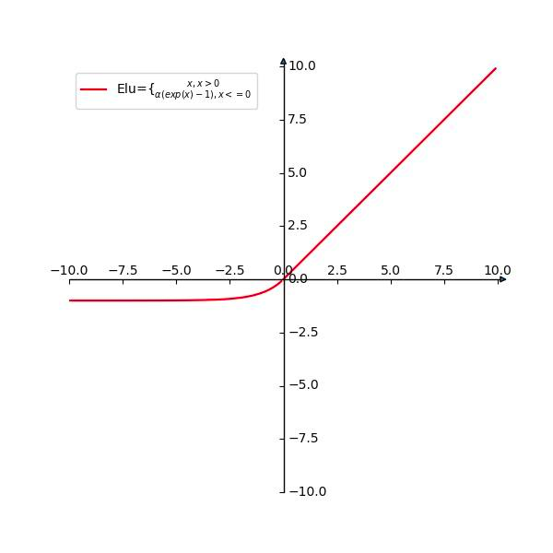
Activation function: ELU
Without the activation function, no matter how many layers we stack together, it could ultimately be replaced by a single one.

Slide 17
Quick Model Overview
Input:
(64,64)
Layer 1 (Convolutional Layer):
5 filters
Filter size is 7X7
Activation : ELU
Layer 2 (Convolutional Layer):
10 filters
Filter size is 7X7
Activation : ELU
Flattened Layer:
31,360
Layer 3 (Fully Connected Layer):
400 neurons
Activation : ELU
Layer 4 (Fully Connected Layer):
80 neurons
Activation : ELU
Layer 5 (Output Layer):
6 neurons
Activation : ELU

Slide 18
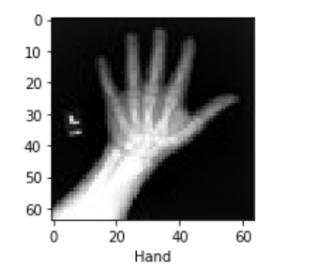
Computing the flattened layer
Input image : 64 X64
5
Layer 1 :
5 filters
Filter size 7X7
60
60

Slide 19
Input Tensor : 60X60X5
5
10
Layer 2 :
10 filters
Filter size 7X7
60
56
60
56

Slide 20
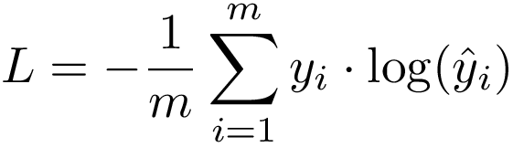

Loss Function : Cross Entropy
Optimizer : Stochastic gradient descent

Slide 21

Define The Layers

Slide 22
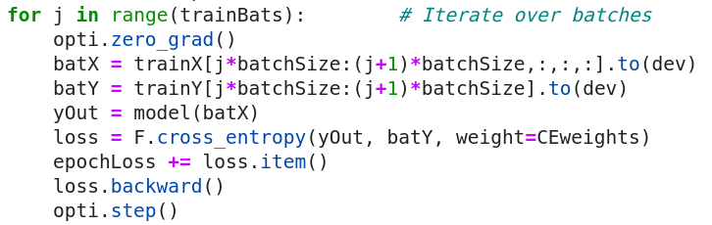
Train The Model

Slide 23
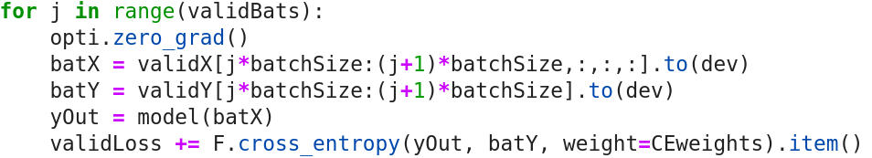
Validation

Slide 24
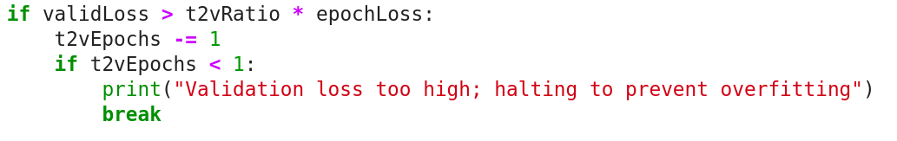
Early stop

Slide 25
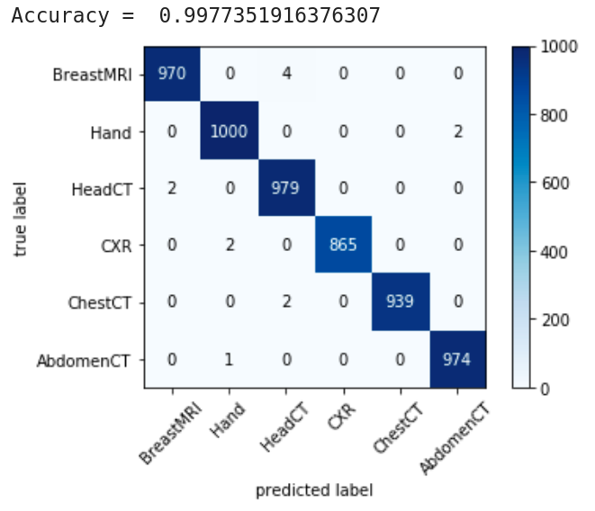
Model Results

Slide 26
Data Augmentation

Slide 27
What Is Data Augmentation ?
Data augmentation is a strategy that enables practitioners to significantly increase the diversity of data available for training models, without actually collecting new data.

Slide 28
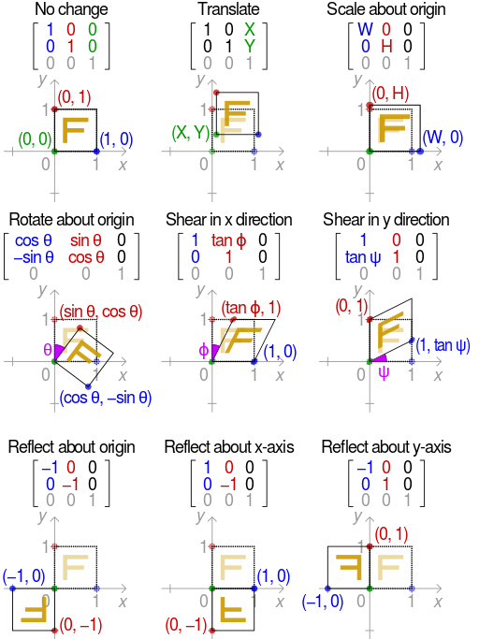
Data augmentation techniques

Slide 29
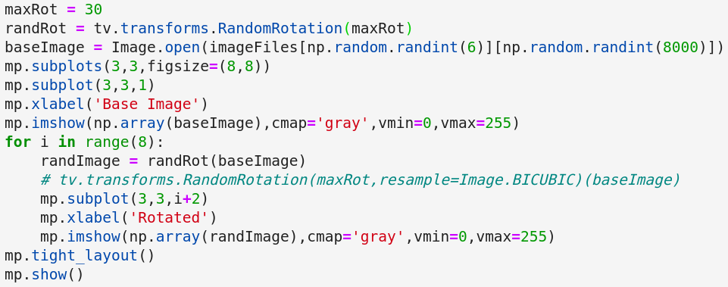
Rotation

Slide 30
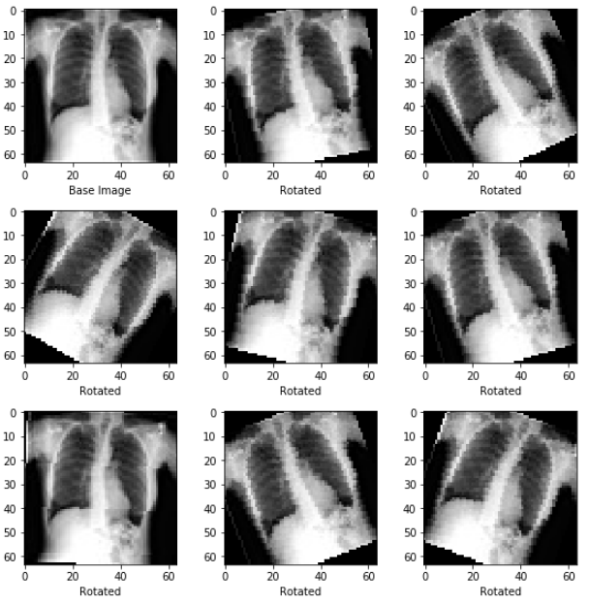
Rotation Result

Slide 31
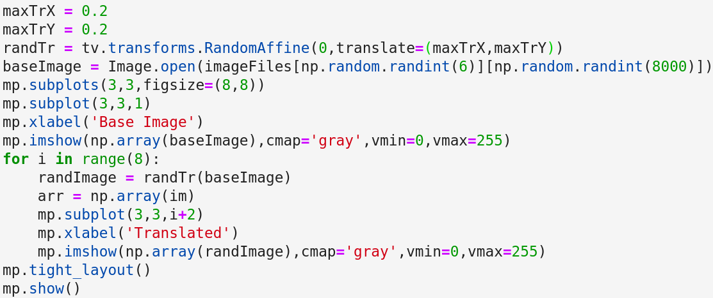
Translations

Slide 32
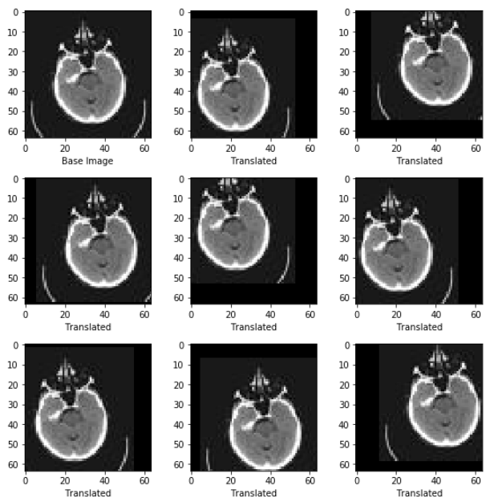
Translations Result

Slide 33
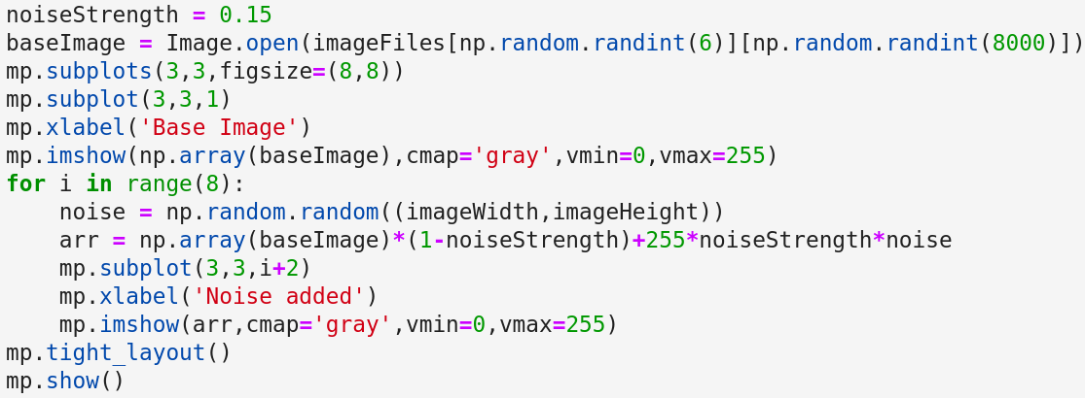
Noise

Slide 34
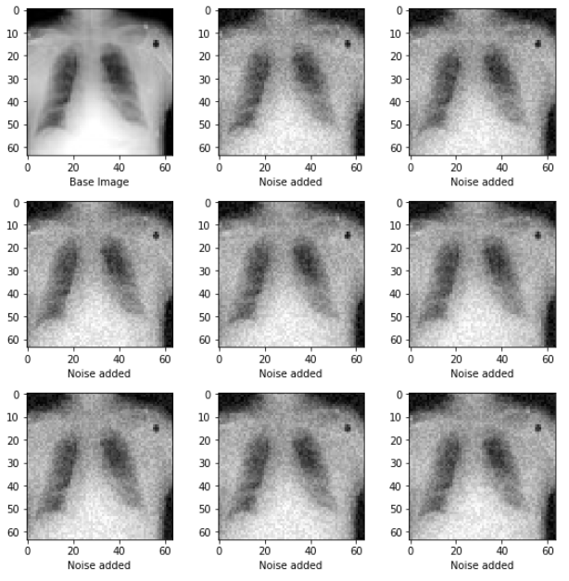
Noise Result

Slide 35
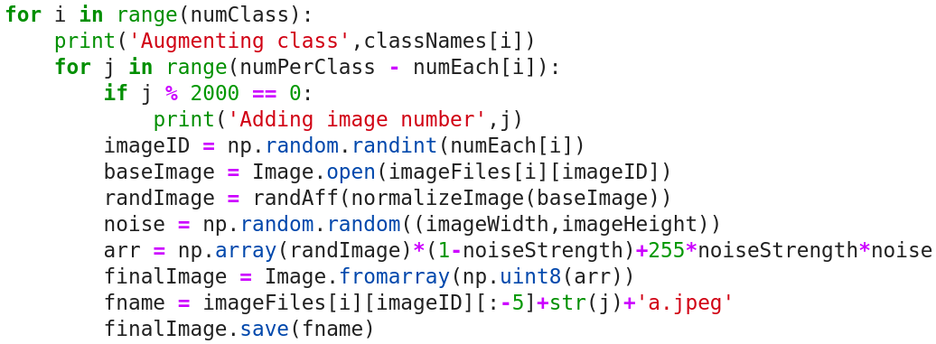
Increase The Dataset

Slide 36
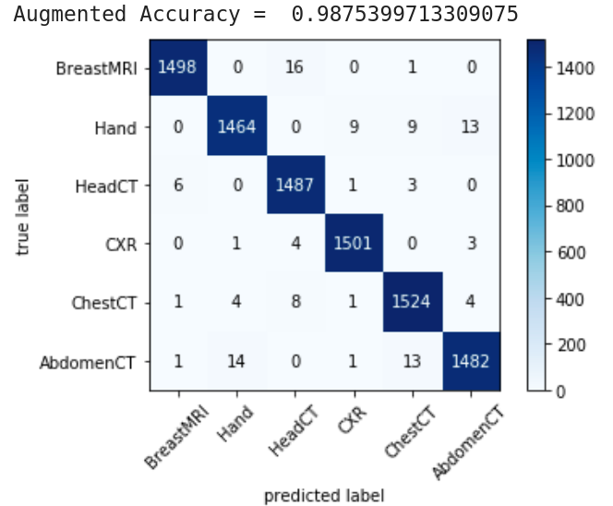
Final Results
Train On MedNIST
And Augmented Data
Train On MedNIST

